Slide 1
Quantum Bank Heist
Kyle and victoria

Slide 2
PHASE 1: Breaking into the Vault
QAOA (Quantum Approximate Optimization Algorithm) implementation (Qiskit):
Custom mixer Hamiltonian to bias low-risk paths.
2-3 QAOA layers for NISQ device feasibility.
Parameter optimization for stealth maximization.
3. Classical-Quantum Hybrid Validation
Benchmarking:
Dijkstra’s algorithm (classical baseline).
Detection probability (target: <10%).
Runtime comparison on IBM Nairobi (7-qubit).
Noise Resilience Testing:
Artificial noise injection to simulate adaptive AI countermeasures.
4. Adaptive Security Integration
Real-time weight updates via security_monitor():
Adjusts graph weights in response to live security changes (e.g., guard rotations).
Output:
Optimal path sequence (e.g., Entrance → Air Duct → Vault).
Time-stratified risk profiles (probability of evasion).
Plan for the Challenge
Plan Graph Representation:
Model the bank's security system as a directed graph where:
Nodes = Checkpoints (e.g., entrance, biometric scanners, laser grids, vault).
Edges = Risk-weighted paths with temporal constraints.
Dynamic Weight Assignment:
Use Python’s NetworkX to assign dynamic weights based on:
Time-dependent security levels (e.g., fewer patrols at night).
Required equipment (e.g., infrared goggles for lasers).
2. QUBO Formulation & Quantum Optimization
Quadratic Unconstrained Binary Optimization (QUBO) encoding:
Path selection → binary variables.
Edge risks → quadratic coefficients.
Constraints enforce valid path continuity.

Slide 3
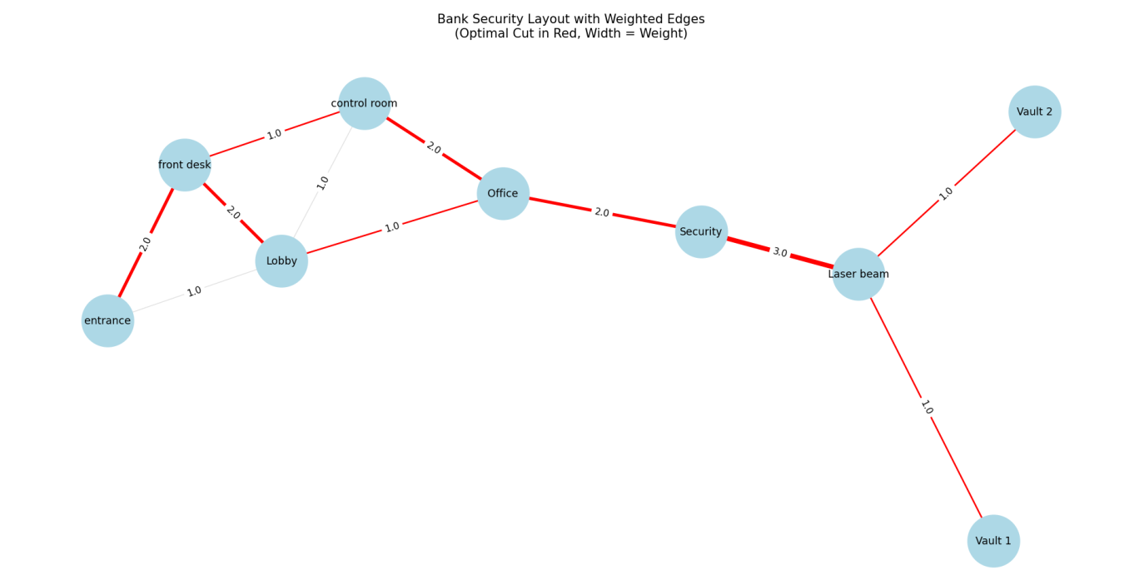
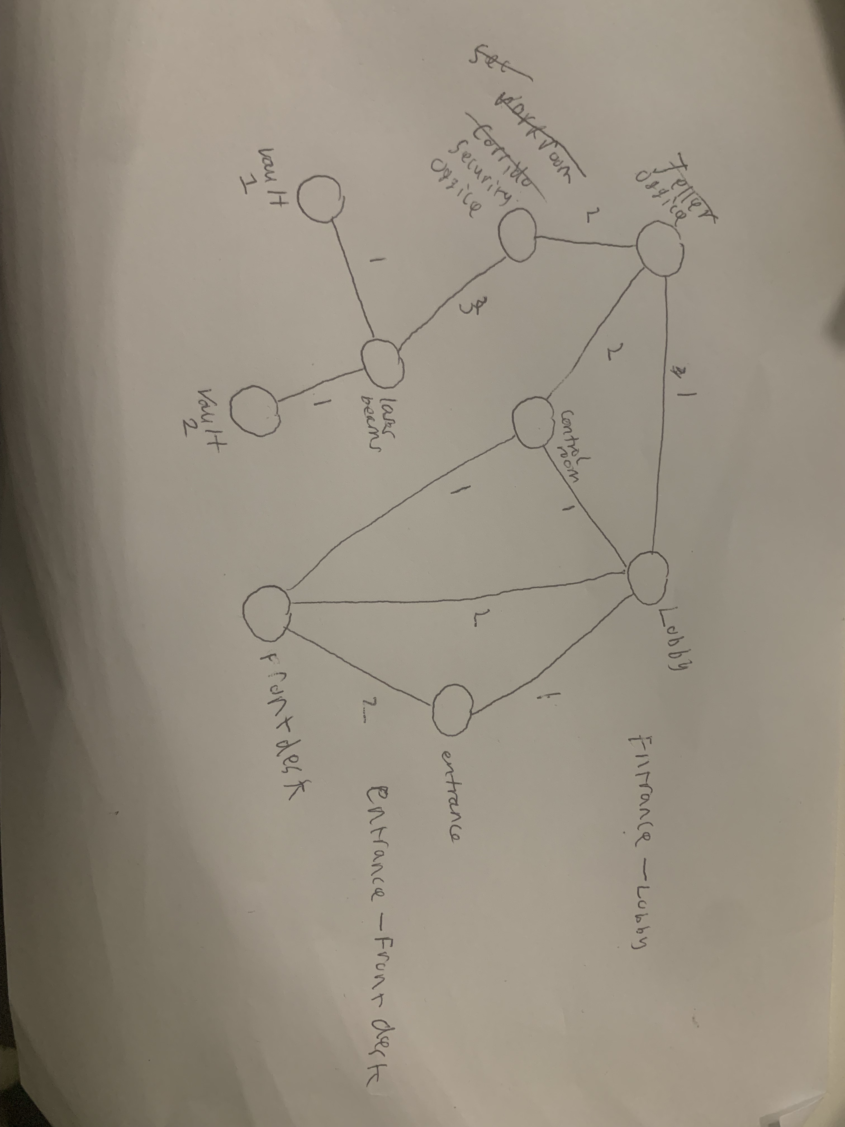
Graph Design
Risk level on arcs: 1-low, 5-high
Initial Design
Coded Product (same graph just orientated slightly differently)

Slide 4
